Slide 1
Collaborative and Contextual Practice
YUANYUAN WANG

Slide 2
Overview
Collaborator:
Media Art student, Jiaxin.
Collaboration:
Composing music for her art films
Reasons:
Practice
Work with a film maker
Portfolio

Slide 3

Project
Context
1. About Time
People - time – life

Slide 4
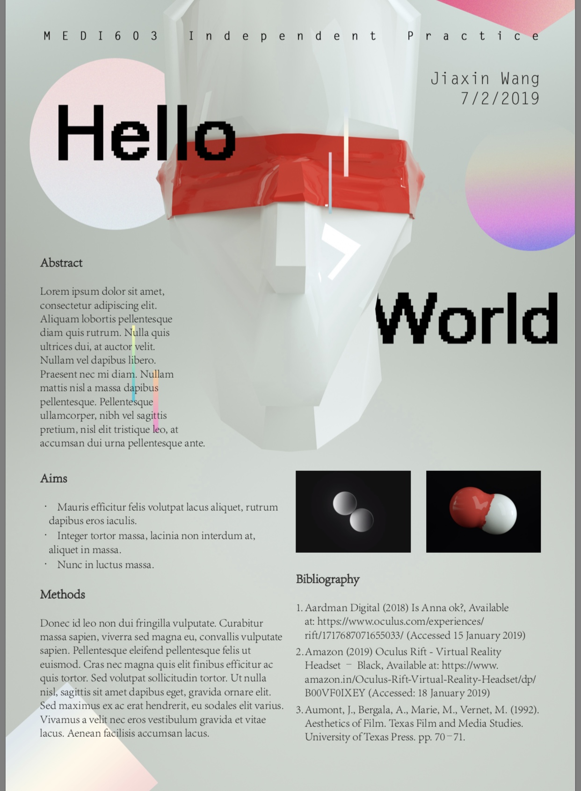
Project
Context
2. Hello World
Plato’s allegory of the cave
Media and people
Sci-fi
Space Atmosphere

Slide 5
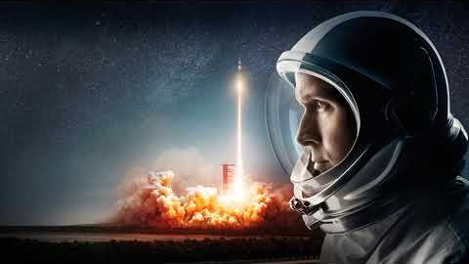


Examples
First Man
Home
Interstellar
S.T.A.Y
https://www.youtube.com/watch?v=Y-GlsoRbGlg
https://www.youtube.com/watch?v=N4o0qnSeVQQ

Slide 6
Aims and Outcomes
Satisfying music for the collaborator
”About Time”, Similar as the temp track
”Hello World”, sci-fi music

Slide 7
Current Progress Timeline
“About Time” 28th February
“Hello World”

Slide 8
Bibliography
Bartkowiak, M. (2010). Sounds of the future. Jefferson, NC: McFarland.
Chitwood, A. (2019). ‘First Man’ Composer Justin Hurwitz on Grief, the Moon Landing, and the Theremin. [online] Collider. Available at: http://collider.com/justin-hurwitz-first-man-interview/ [Accessed 20 Mar. 2019].
Green, J. (2010). Understanding the Score: Film Music Communicating to and Influencing the Audience. The Journal of Aesthetic Education, [online] 44(4), pp.81-94. Available at: https://www.jstor.org/stable/10.5406/jaesteduc.44.4.0081?seq=1#page_scan_tab_contents.
Hurwitz, J. (2019). First Man (Original Motion Picture Soundtrack). [online] Spotify. Available at: https://open.spotify.com/album/2mFzDyWdDyI8HcLRyMXGgV [Accessed 19 Mar. 2019].
Lubin, G. (2014). The Story Of How Hans Zimmer Wrote The 'Interstellar' Theme. [online] Business Insider. Available at: https://www.businessinsider.com/how-hans-zimmer-wrote-the-interstellar-theme-2014-11?r=US&IR=T [Accessed 19 Mar. 2019].
YouTube. (2013). Sound of Cinema The Music that Made the Movies Part 3 New Frontiers. [online] Available at: https://www.youtube.com/watch?v=OPm6BCvnK5Y [Accessed 19 Mar. 2019].
Zimmer, H. (2019). Interstellar: Original Motion Picture Soundtrack. [online] Spotify. Available at: https://open.spotify.com/album/7a78GiEowpaCa7ZJs44xUU [Accessed 20 Mar. 2019].

